Slide 1
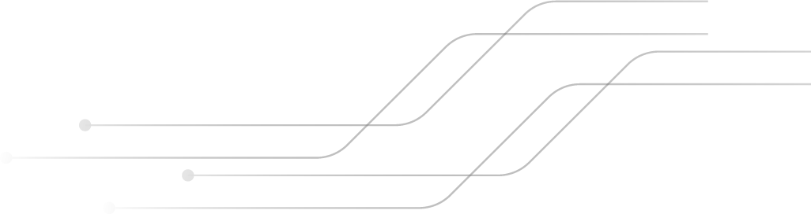

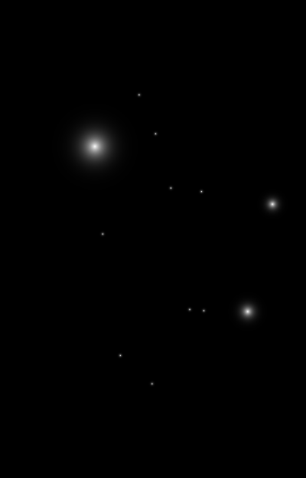
6th Semester Final Presentation
on
Ultrasonic Radar System
Under the Guidance Of
Dr.Sumana Ma’am
Presented By: Roll No
Rounak Anand DL/025/22
Satyam Kr Sinha D/059/21
Vivekanand Singh D/086/21
Guru Gaurav D/50/21

Slide 2

Introduction
The ultrasonic sensor projects sound waves that, upon encountering an obstacle, reflect back to the origin point. The sensor captures the reflected waves, and the Arduino computes the elapsed time between emission and reception. This temporal measurement is then converted into spatial distance, providing an accurate estimation of the object’s location.

Slide 3
Components Required
COMPONENTS | Function
Arduino Uno | The Arduino Uno is essential for coordinating the different parts of the radar system and making sure everything works together smoothly.
Ultrasonic Sensor | The ultrasonic sensor emits sound waves that bounce off objects and return to the sensor.
Servo Motor | The servo motor rotates the ultrasonic sensor to various angles, allowing it to scan a wider area
Buzzer | It can provide feedback to the user in the form of sound alerts when certain conditions are met.
LCD Display | It is typically used to show real-time information about the objects detected by the ultrasonic sensor.
LED light | Multiple LEDs is used to indicate different distance ranges
I2C Module | It is used to simplify the connection between an LCD display and the Arduino board.

Slide 4
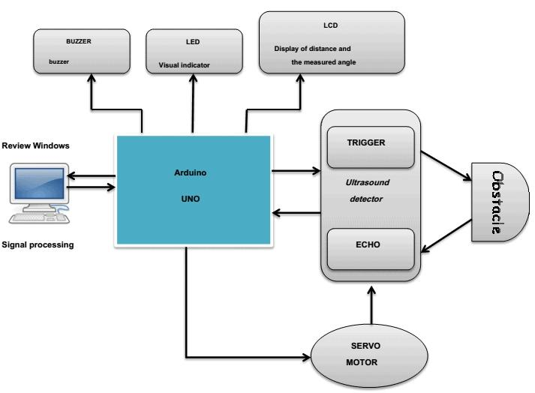
Block Diagram

Slide 5
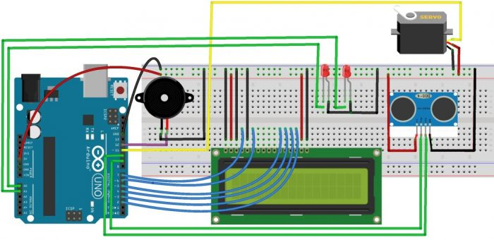
Circuit Diagram

Slide 6
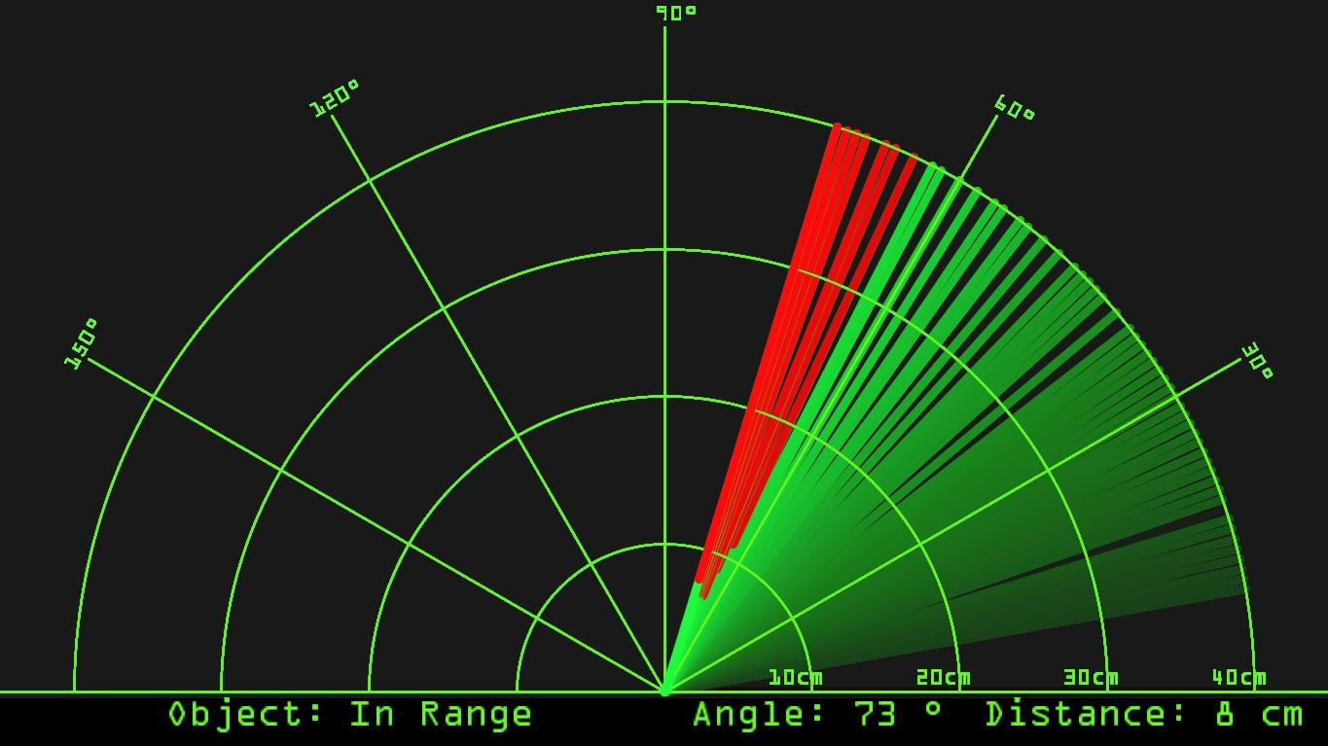
PC Radar Interface Working
On the PC, the Processing IDE receives the data from the Arduino.
It uses this data to draw a visual representation of the radar system.
The interface typically shows a circular display with lines that represent the distances measured by the sensor.
The PC interface updates in real-time as the sensor detects objects and the servo motor changes its position.
This allows the user to see a live feed of the radar’s findings.

Slide 7


Working
The ultrasonic sensor is mounted on a servo motor that rotates
in a circular path.
• As the ultrasonic sensor rotates, it transmits ultrasonic waves
and listens for reflected waves.
• If the ultrasonic sensor detects an obstacle, the reflected waves
will be received by the sensor.
• The time it takes for the waves to travel back and forth is used
to calculate the distance of the obstacle.
• The angle of the obstacle is determined by the position of the
servo motor when the obstacle is detected.
• The distance and angle of the obstacle are displayed on the LCD
screen.
• The LEDs are used to indicate whether an obstacle has been
detected at different distance

Slide 8
Applications
ROBOTICS
OBJECT TRACKING
TRAFFIC MONITORING
It can help robots navigate by avoiding obstacles and mapping their surroundings
The radar can track the movement of objects, which is useful in industrial automation
It can be used to monitor vehicle traffic and detect congestion in parking lots

Slide 9

PROJECT GOALS
Distance Measurement and Angle Detection
Data Acquisition and Processing
Real Time Monitoring and Visualization

Slide 10
Action Plan Execution
TOTAL TASK | DESCRIPTION | TIME UTILIZED
TASK 1 | Hardware Assembly for Ultrasonic Radar System | 50hrs
TASK 2 | Software Programming for Ultrasonic Radar System | 42hrs
TASK 3 | PC Radar Interface Setup and Integration | 46hrs
TASK 4 | Testing and Documentation | 45hrs

Slide 11
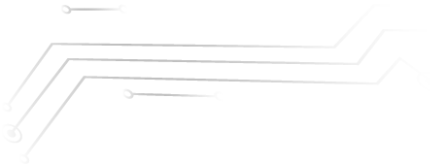
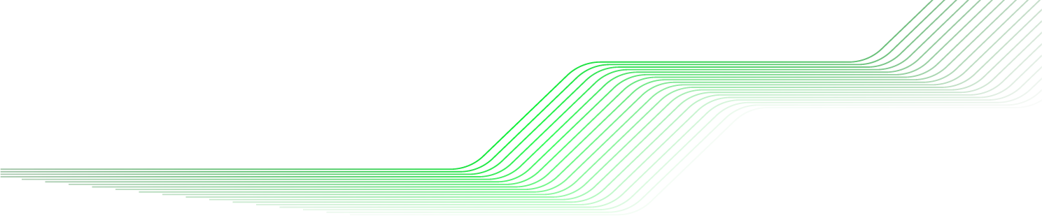
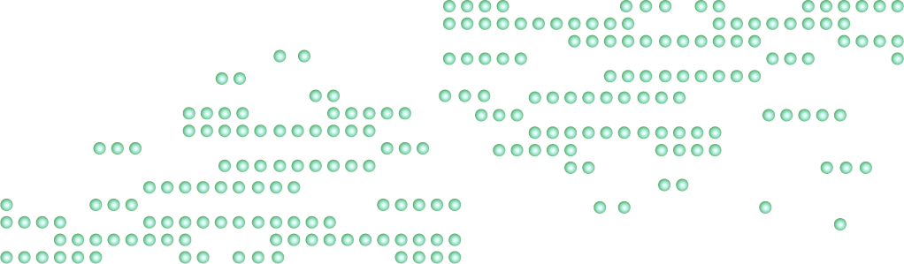
References
Sideshow.com
Britannica.com
Howtodoelectronics.com

Slide 12
Thank You

